Slide 1
Microwave Integrated Circuits
Microchip for Microwave frequencies.
It can incorporate innumerable components of different types, (passive and active) into a small chip to form a complete microwave subsystem.
Size, weight and cost are reduced much.

Slide 2
Types of Microwave circuits
Discrete circuit:
Packaged diodes/transistors mounted in coaxial and waveguide assemblies.
Devices can usually be removed from the assembly and replaced.
Hybrid MIC:
Diodes/transistors, resonators, capacitors, circulators etc., are fabricated separately on most appropriate material and then mounted into the microstrip circuit and connected with bond wires
MMIC :
Diodes/transistors, resistors, capacitors, microstrip etc., are fabricated simultaneously, including their interconnections, in semiconductor chip

Slide 3
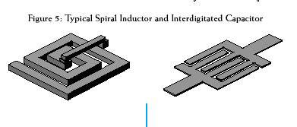
Typical spiral inductor and interdigitated capacitor
Loop inductor
High impedance transmission line inductor
Figure: Microstrip elements used in MMIC

Slide 4
MMIC
The substrate of an MMIC must be a semiconductor material to accommodate the fabrication of active devices and devices consisting, several layers of metal, dielectric and resistive films.
Potentially, the MMIC can be made at low cost because the manual labour in the fabrication of hybrid MICs is eliminated and that a single wafer can contain a large number of circuits, all of which can be processed and fabricated simultaneously.

Slide 5
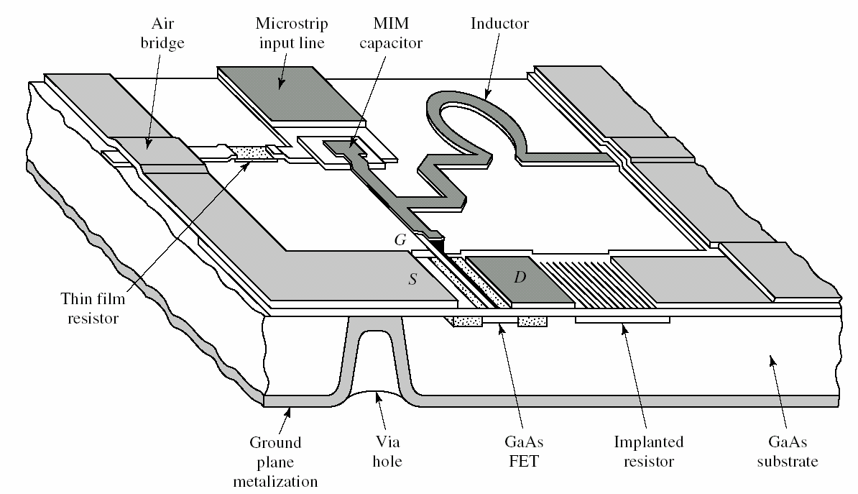
Monolithic Microwave Integrated Circuit (MMIC)

Slide 6
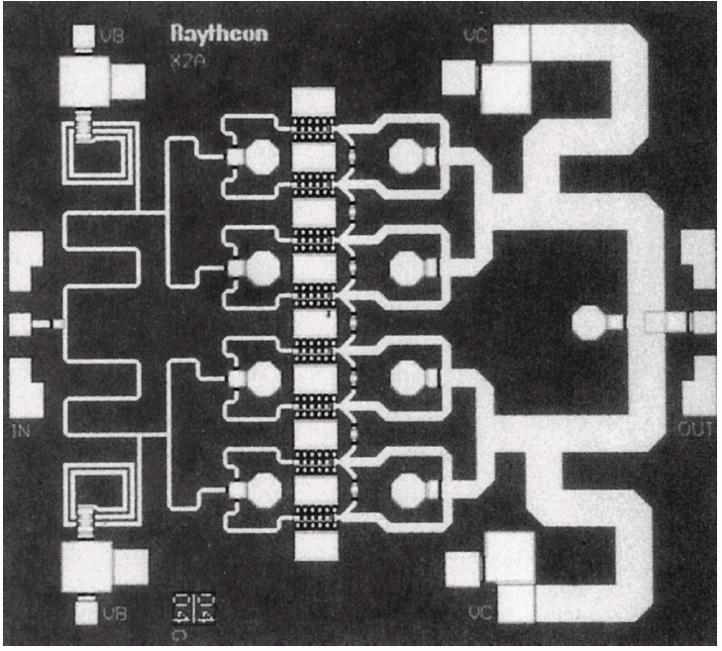
Photograph of a monolithic integrated X-band power amplifier. This circuit uses eight heterojunction bipolar transistors with power dividers/combiners at the input and output to produce 5 watts.

Slide 8
Advantages and Disadvantages of MMICs
Advantages:
1- Minimal mismatches and minimal signal delay.
2- There are no wire bond reliability problems.
3- Up to thousands of devices can be fabricated at one time into a single MMIC.
4- It is the least expensive approach when large quantities are to be fabricated.
Disadvantages:
1- Performance compromised, since the optimal materials cannot be used for each circuit element.
2- Power capability is lower because good heat transfer materials cannot be used
3- Trimming adjustments are difficult or impossible.
4- Unfavorable device-to-chip area ratio in the semiconductor material.
5- Tooling is prohibitively expensive for small quantities of MMIC.

Slide 9
Materials used for MIC
Substrate materials
sapphire, alumina, ferrite/garnet, silicon, RT/duroid, quartz, GaAs, Inp, etc.,
Conductor materials
copper, gold, silver, aluminum, etc.
Dielectric films
SiO, SiO₂,…etc
Resistive films
Nichrome (cNiCr), tantalum (Ta)

Slide 10
Commonly used substrate materials
1. Organic PCBs (Printed Circuit Boards)
FR4
1) Low cost, rigid structure, and multi-layer capability.
2) Applications for operation frequency below a few GHz.
fop↓ ⇒ Loss ↓
RT/Duroid
1) Low loss and good for RF applications.
2) Board has a wide selected range for permittivity. e.g. RT/Duroid 5870 with ε_{r} =2.33, RT/Duroid 5880 with ε_{r} =2.2, and RT/Duroid 6010 with ε_{r} =10.2.
3) Board is soft leading to less precise dimensional control.
2. Plastic substrate
1) This is suitable for experimental circuits operating below a few GHz and array antennas operating up to and beyond 20 GHz.

Slide 11
3. Alumina
1) Good for operation frequency up to 40 GHz.
2) Metallic patterns can be implemented on ceramic substrate using thin-film or thick-film technology.
3) Passive components of extremely small volume can be implemented because the ceramic substrate can be stacked in many tens of layers or more, e.g. low temperature co-fired ceramic (LTCC).
4) Good thermal conductivity.
5) Alumina purity below 85% should result in high conductor and dielectric losses and poor reproducibility.
4. Quartz
1) Production circuits for millimetric wave applications from tens of GHz up to perhaps 300 GHz, and suitable for use in finline and image line MIC structures.
2) Lower permittivity of property allows larger distributed circuit elements to be incorporated.

Slide 12
5. Sapphire
The most expensive substrate with following advantages:
1) Transparent feature is useful for accurately registering chip devices.
2) Fairly high permittivity (ε_{r} =10.1~10.3), reproducible ( all pieces are essentially identical in dielectric properties), and thermal conductivity (about 30% higher than the best alumina).
3) Low power loss.
Disadvantages:
1) Relatively high cost.
2) Substrate area is limited (usually little more than 25 mm square).
3) Dielectric anisotropy poses some additional circuit design problems.

Slide 13
6. Beryllia (BeO) and Aluminium Nitride (AlN):
Ceramic substrate.
Excellent thermal conductivity – high power applications.
Dangerous to handle – Its dust is toxic and must not be machined.
7. GaAs:
Suitable for MMICs. Lownoise MESFET, Power MESFET, Schottky diodes are fabricated on GaAs.

Slide 14
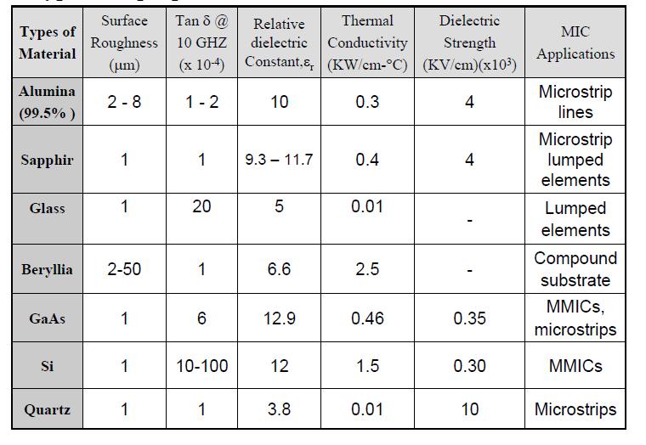

Slide 15
Conductor Materials
Properties:
High conductivity
High coefficient of thermal expansion
Low resistance at RF/microwaves
Good adhesion to the substrate
Good etch ability and solder ability
Easy to deposit or electroplate
Example:
HMIC: Cr/Au, Pd/Au, Ta/Au
MMIC: Cr/Au, Ti/Pd/Au, Ti/Pt/Au

Slide 16
Properties of Conductors :

Slide 17
Dielectric Films
Reproducibility
High breakdown voltage
Low loss tangent
Ability to Process without developing pinholes.
Capacitors
Protective layers for active devices
Insulating layers for passive circuits

Slide 18
Properties of Dielectrics :

Slide 19
Resistive Films
Good stability
Low Temperature Coefficient of Resistance (TCR)
Sheet resistivity (10-2000 Ω/square)
Terminations
Attenuators
Bias Networks
Examples:
Cr, NiCr, Ta, Cr-Sio, Ti

Slide 20
Properties of Resistive Films :

Slide 21
Properties of Various Manufacturing Technology

