Slide 1
Practical Applications of Strain Gauges
Elizabeth Phillips

Slide 2




Then & Now: Under Stress
This link is about how measuring stress has changed over the years to the present day.
These strain gauges are use to measure the amount of stress an airplane can handle until it fails.
Wings need to be strong in order to fly correctly. Testing the amount of strain a material can take allows engineers to find the strongest material for their planes.
This application would best fit into the Civil Engineering Branch

Slide 3
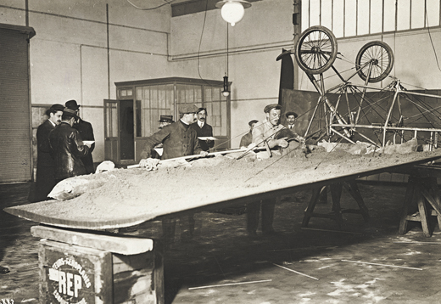
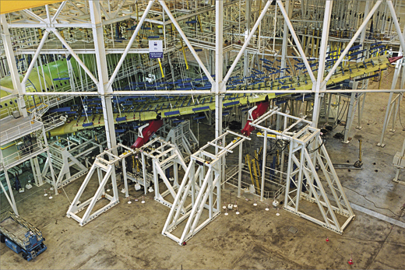
Then & Now: Under Stress
Continued
Before there were strain gauges, people used sand to measure the stress level of an airplane’s wing.
The strain gauge was invented in only 18 years.
THEN NOW

Slide 4



Smart Bridges
In order to keep bridges in good condition, people have put sensors on bridges to monitor the weak points of a bridge.
Many different types of sensors are put on various places on a bridge to get different readings from the bridge. The sensors measure the stress on the bridge so if it becomes abnormal someone can fix the problem. Different sensors measure different things. Photonic sensors measure the strain on bridge cables, thermistors measure the temperature, and vibrating wire strain gauges measure vibrations on the bridge.
These sensors tell us if a bridge gets weak at some points so that they can be fixed before the bridge can break.
This information would be most useful for bridge maintenance companies

Slide 5
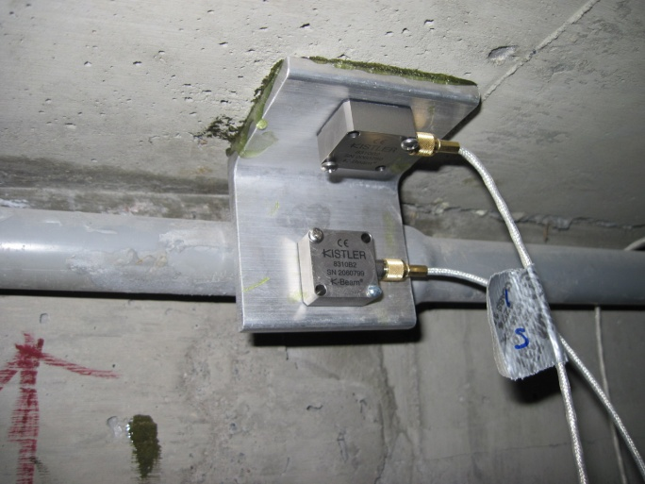
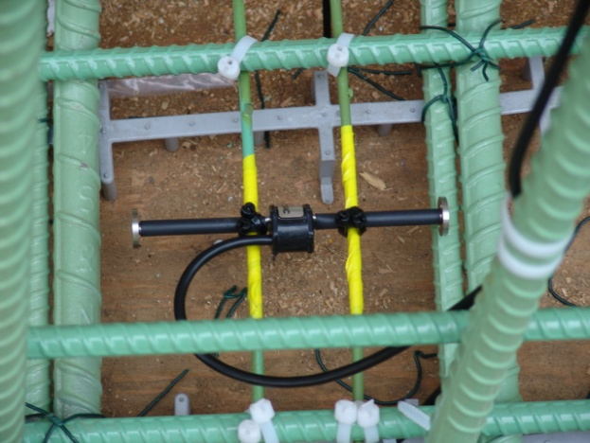

Smart Bridges Continued
Using sensors on bridges to keep up maintenance was a very smart idea.
The Tsing Ma Bridge in Hong Kong has 350 sensors to measure it.

Slide 6
Strain Gauges and Rail Forces
Strain gauges are used to keep rails in good condition.
These strain gauges are put on the rails in a vertical, longitudinal, and lateral positions to measure different forces. The gauges go on the top, bottom, and sides of the rail. Just like the smart bridges, these sensors are used to maintain good conditions to the rails. The train goes over the rails and trigger the sensors. The data is measured and appropriate action is taken to fix the rails if needed.
The gauges are important because it keeps the rail in good condition.
This information would be useful to railroad maintenance workers.

Slide 7
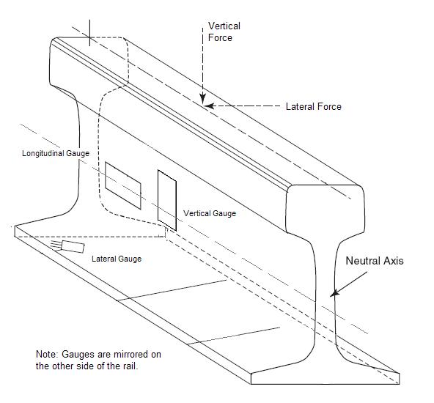
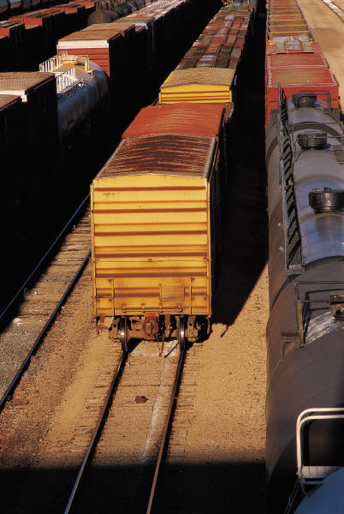
Strain Gauges and Rail Forces Continued
Not only do the sensor help people keep the rail in good condition, it helps keep the rails from breaking by eliminates the effects of any lateral bending that could reduce or exaggerate a strain reading taken on only one side of the rail.

Slide 8
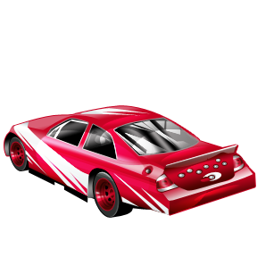
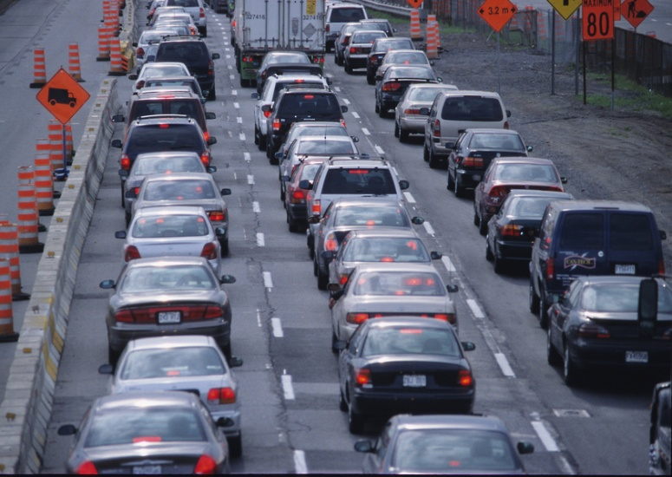

Vehicle Classifications using Strain Gauge
Students in the University of California are trying to identify what type of car is driving on the road using only a strain gauge.
The strain gauges are installed in a bridge deck to measure how much strain is put on the sensor. A car will drive over the gauge and apply strain. The more strain that is put on the sensor, the bigger the vehicle.
The purpose of the sensor is to find a pattern of what types of areas use what cars to classify them, to monitor traffic in different areas, and protect the privacy of transportation users.
Engineers who work with cars like mechanical engineers would fit this experiment best.
This information could be useful to many people such as road companies and companies that provide toll booths.

Slide 9
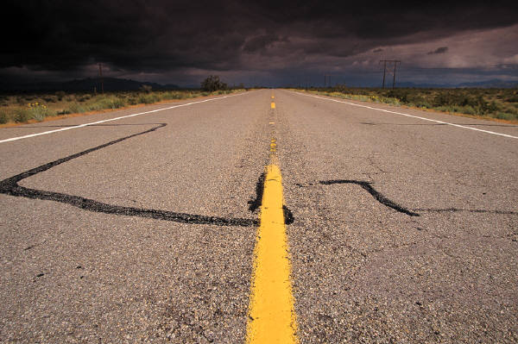

Vehicle Classifications using Strain Gauge Continued
Its interesting that every vehicle makes a different type of strain signal.

Slide 10

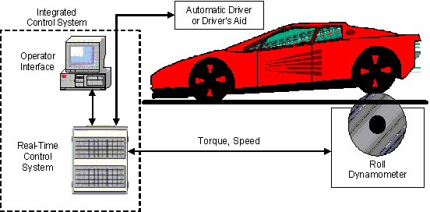
Dynos
A strain gauge is attached to a dyno in order to measure torque on an engine.
A dyno is connected to a flywheel or crankshaft and a strain gauge is attached to the frame of the dyno to measure the torque. When the engine starts, the strain gauge measures the spinning wheel and converts it to torque.
The strain gauge makes it much easier to measure torque.
Automotive companies could use this information to find out more about their cars.

Slide 11
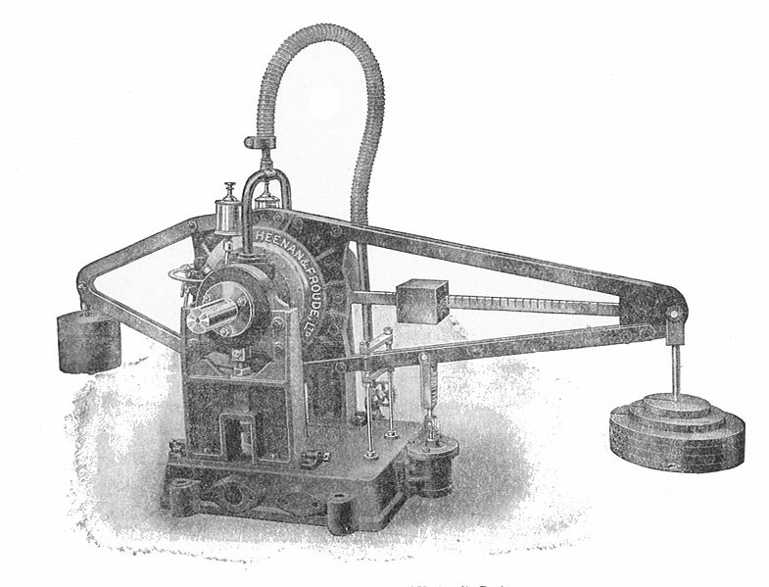
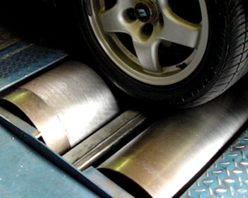
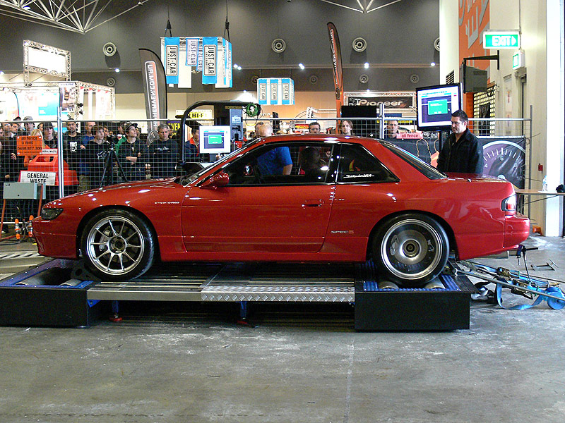
Dynos Continued
2 interesting things about dynos are 1. being able to use several devices to achieve one certain measurement and 2. finding out that strain gauges for many different things.

